Slide 1
User Interface Design and Evaluation
Chapter 6 Interaction Design

Slide 2
Contents
6.1 Design Framework
6.2 Design Techniques and Rules
6.3 Design Details

Slide 3

6.1 Design Framework

Slide 4


Why design framework is needed?
Detail design

Slide 5
Design Framework
defines the overall structure of the users’ experience
Notes:
At this phase in a project, interaction designers use scenarios and requirements to create rough sketches of screens and behaviors that make up the interaction
framework.
Concurrently, visual designers use visual language studies to develop a visual design framework that is commonly expressed as a detailed rendering of a single
screen archetype.
Industrial designers execute form language studies to work toward a rough physical model and industrial design framework.
Service designers build models of the information exchange for each touch point in a service framework.
We’ve found that sketch-like storyboards of context and screens, accompanied by narrative in the form of scenarios, are a highly effective way to explore and discuss design solutions
without creating undue overhead and inertia.

Slide 6
The Framework Definition Process
Notes:
Even though we’ve broken the process into numerically sequenced steps, typically this is not a linear effort. Rather, it occurs in iterative loops. In particular, Steps 3 through 5 may be switched, depending on the designer’s thought process (more on this later). The six steps are described in the following sections.

Slide 7
Step 1: Define form factor
What constraints does each of these form factors imply for any design?
Is it a web application that will be viewed on a high-resolution computer screen?
Is it a phone that must be small, light, low-resolution, and visible in both bright sunlight and the dark?
Is it a kiosk that must be rugged to withstand a public environment while accommodating thousands of distracted novice users?
Notes:
Where a product requires the design of both hardware and software, these decisions also involve industrial design considerations.

Slide 8
Step 1: Define Posture
A product's posture is related to
how much attention the user will devote to interacting with the product.
how the product's behaviors respond to the kind of attention the user will devote to it.
This decision should be based on usage contexts and environments

Slide 9
Step 1: Define Input Method
How users will interact with the product.
This is driven by the form factor and posture, as well as by your personas' attitudes, aptitudes, and preferences.
Decide which combination is appropriate for your primary and secondary personas.
Notes:
Choices include keyboard, mouse, keypad, thumb-board, touchscreen, voice, game controller, remote control, dedicated hardware buttons, and many other possibilities.
If you need to use a combination of input methods (such as the common website or desktop application that relies on both mouse and keyboard input), decide on the product's primary input method.

Slide 10
Step 2: Define Data Elements
typically are the fundamental subjects of interactive products.
consider the relationships between data elements.

Slide 11
Step 2: Define Functional Elements
Functional elements are the operations that can be done to the data elements and their representations in the interface.
Generally speaking, they include tools to act on and ways to visually and structurally manage data elements.
It is common for a single requirement to necessitate multiple interface elements.

Slide 12
Step 2: Define Functional and Data Elements
Ask yourself which of the possible solutions is most likely to do the following:
Accomplish user goals most efficiently.
Best fit your design principles.
Fit within technology or cost parameters.
Possibly differentiate the interaction from the competition.
Best fit other requirements.
Notes:
typically a number of solutions are possible.

Slide 13
Step 3: Determine Functional Groups and Hierarchy
Here are some issues to consider:
Which elements need a large amount of screen real estate, and which do not?
Which elements are containers for other elements?
How should containers be arranged to optimize flow?
Which elements are used together, and which are not?
In what sequence will a set of related elements be used?
What data elements would be useful for the persona to know or reference at each decision?
What interaction patterns and principles apply?
How do the personas' mental models affect organization?

Slide 14
Step 3: Determine Functional Groups and Hierarchy
It's important to organize data and functions into top-level container elements.
Such as screens, frames, and panes.
Consider which primary screens or states the product requires.
When grouping functional and data elements, consider how they should be arranged given the product’s platform, posture, screen size, form factor, and input methods.
Notes:
These groupings may change somewhat as the design evolves (particularly as you sketch the interface), but it’s still useful to provisionally
sort elements into groups. This will speed up the process of creating initial sketches. Again, indented lists or simple Venn diagrams are appropriate at this point for documenting these relationships.

Slide 15
Step 4: Sketch the Interaction Framework
Rectangles phase

Slide 16
Step 5: Construct Key Path Scenarios
A key path scenario describes how the persona interacts with the product, using the vocabulary of the interaction framework.
These scenarios depict the primary pathways through the interface that the persona takes with the greatest frequency, often on a daily basis.
Key path scenarios focusing on task details broadly described and hinted at in the context scenarios.
Key path scenarios must describe in detail the behavior of each major interaction and provide a walkthrough of each major pathway.

Slide 17
Step 5: Construct Key Path Scenarios
Storyboarding
By using a sequence of low-fidelity sketches accompanied by the narrative of the key path scenario, you can richly portray how a proposed design solution helps personas accomplish their goals
This technique of storyboarding is borrowed from filmmaking and cartooning, where a similar process is used to plan and evaluate ideas without having to deal with the cost and labor of shooting actual film.

Slide 18
Step 5: Construct Key Path Scenarios
Storyboarding
provides a reality check of the interactions' coherence and flow.
A more evolved Framework rendering from the Cross Country TravCorps job search web application

Slide 19
Step 5: Construct Key Path Scenarios
Process variations and iteration
It is common to move back and forth between steps and to iterate the whole process several times until you have a solid design solution.
Depending on how you think, you have a couple of different ways to approach Steps 3 through 5.

Slide 20
Step 5: Construct Key Path Scenarios
Verbal thinkers
Key path scenarios
↓
Work out the groupings verbally
↓
Sketch
Visual thinkers
Sketch
↓
Key path scenarios
↓
See if your groupings work with the scenarios

Slide 21
Step 6: Check Designs with Validation Scenarios
These validation scenarios typically are not developed in as much detail as key path scenarios.
The goal is to poke holes in the design and adjust it as needed

Slide 22
Step 6: Check Designs with Validation Scenarios
You should address three major categories of validation scenarios, in the following order:
Alternative scenarios
Necessary-use scenarios
Edge-case use scenarios

Slide 23
Defining the Visual Design Framework
The visual design framework typically follows this process:
Develop experience attributes.
Develop visual language studies.
Apply the chosen visual style to the screen archetype.

Slide 24
Step 1: Develop Experience Attributes
The first step in defining a visual design framework to choose a set of three to five adjectives that will be used to help define the tone, voice, and brand promise of the product.
This set of descriptive keywords are collectively called experience attributes（体验特征）.
Notes:
The process used at Cooper for generating experience attributes is as follows:
1 Gather any existing brand guidelines. Familiarize yourself with them. If the company has clear brand guidelines built around one product—the product you're designing—
much of your work may have already been done for you.
2 Gather together examples of strongly branded products, interfaces, objects, and services. Including multiple examples from particular domains will help
stakeholders think about their differences. If we include images of cars, for instance, we might include examples from BMW, Toyota, Ferrari, and Tesla.
3 Work with stakeholders to identify direct and indirect competition. Gather examples of these products and services' products and interfaces to include in your examples.
4 Pull relevant terms mentioned by interviewees in the course of your qualitative research. Pay particular attention to any pain points mentioned. For instance,
if many mention that a competitor or the existing version of the product is hard to use or "unintuitive," you may want to discuss whether "friendly," "easy," or
"understandable" should be an attribute.
5 With the brand guidelines, example products, competition, and user notes on display to reference, have a discussion with stakeholders about the sub-brand of the product
you're designing. We often ask stakeholders to vote for and against examples by placing red or green stickers on them, and then discuss any clear winners, losers, or
controversial examples.
6 From the outcomes of this discussion, identify the minimum number of adjectives that define and distinguish the product.
7 If any of the words have multiple meanings, document the exact sense intended. "Sharp," for instance, could refer to precision and sleekness, or it could mean
intelligence and wit.
8 Consider competitors. If your set of attributes does not distinguish the brand from competitors, refine them until they do. Also make sure that individual attributes are
aspirational. "Smart" is good. "Brilliant" is better.
9 Check back with the stakeholders (and especially any marketers) on your proposed attribute set to discuss and finalize them before moving forward.

Slide 25
Step 2: Develop Visual Language Studies
These studies are based on the experience attributes and include color, type, and widget treatments.
They also include the overall dimensionality and any “material” properties of the interface.
These aspects abstractly and independent of the interaction design.
Visual language studies should relate to the personas’ experience goals, as well as to any experience or brand keywords that were developed in the requirements definition phase.

Slide 26
Step 2: Develop Visual Language Studies

Slide 27
Step 2: Develop Visual Language Studies
Substantial work is often required to translate a style guide for marketing collateral into a meaningful look and feel for an interactive product or website.
It's also important to consider environmental factors and persona aptitudes when devising visual styles.

Slide 28
Step 2: Develop Visual Language Studies
Once you've developed a good spectrum of visual language studies reflecting persona experience goals, brand guidelines, and experience keywords, it's time to present them to stakeholders for feedback.
It's important to contextualize them in terms of these goals and keywords and to describe the rationale for each direction and its relative merits.
It is common to iterate the visual language studies before moving on to the next step.

Slide 29
Step 3: Apply the Chosen Visual Style to the Screen Archetype
The final step is to apply one or two selected visual styles to key screens.

Slide 30
Defining the Industrial Design Framework
The industrial design framework is developed in much the same manner as the visual design framework.
But because the form factor and input method have significant implications for both the industrial and interaction design, it's useful to collaborate early on to identify relevant issues.

Slide 31
Defining the Industrial Design Framework
The industrial design framework typically follows this process:
Collaborate with interaction designers about form factor and input methods.
Develop rough prototypes.
Develop form language studies.

Slide 32
Defining the Service Design Framework
Because service design often affects organizations' business models, the service design framework may be conducted before other areas of design.

Slide 33
Defining the Service Design Framework
The service design framework typically follows this process:
Describe customer journeys.
Create a service blueprint.
Create experience prototypes.

Slide 34
Refining the Form and Behavior
At this stage, a transition is made into the Refinement phase, where the design is translated into a final, concrete form.
In this phase, principles and patterns remain important in giving the design a fine formal and behavioral finish.
The Refinement phase is marked by the translation of the sketched storyboards into full-resolution screens that depict the user interface at the pixel level

Slide 35
Refining the Form and Behavior

Slide 36
Refining the Form and Behavior
During this phase, you should address every primary view and dialog possible.
Throughout the refinement phase, visual designers should develop and maintain a visual style guide.
Developers use this guide to apply visual design elements consistently when they create low-priority parts of the interface that the designers typically don't have the time and resources to complete themselves.
At the same time, industrial designers work with mechanical engineers to finalize components and assembly.

Slide 37
Refining the Form and Behavior
While the end product of the design process can be any one of a variety of outputs, we often create a printable Form and Behavior Specification.
screen renderings with callouts sufficiently detailed for a developer to code from
detailed storyboards to illustrate behaviors over time
an interactive prototype in HTML or Flash
However, keep in mind that prototypes alone are rarely sufficient to communicate underlying patterns, principles, and rationale, which are vital concepts to communicate to developers.

Slide 38
Validating and Testing the Design
What to test
Naming—Do section/button labels make sense? Do certain words resonate better than others?
Organization—Is information grouped into meaningful categories? Are items located in the places customers might look for them?
First-time use and discoverability—Are common items easy for new users to find? Are instructions clear? Are instructions necessary?
Effectiveness—Can customers efficiently complete specific tasks? Are they making
missteps? Where? How often?

Slide 39
Validating and Testing the Design
When to test: Summative and formative evaluations
Summative evaluations are used in product comparisons, to identify problems prior to a redesign, and to investigate the causes of product returns and requests for training and support.
Summative studies generally are conducted and thoroughly documented by professional third-party evaluators.

Slide 40
Validating and Testing the Design
Formative evaluations are conducted during the design process, generally during the Refinement phase.
It allows the designers to see how (and, with interviews, why) their target audience responds to the information and tools they’ve provided to help them accomplish their tasks.

Slide 41
Conducting Formative Usability Tests
Essential components of successful formative usability tests:
Test late enough in the process that there is a substantially concrete design to test, and early enough to allow adjustments in the design and implementation.
Test tasks and aspects of the user experience appropriate to the product at hand.
Recruit participants from the target population, using your personas as a guide.
Ask participants to perform explicitly defined tasks while thinking aloud.

Slide 42
Conducting Formative Usability Tests
Essential components of successful formative usability tests:
Have participants interact directly with a low-tech prototype (except when testing specialized hardware where a paper prototype can’t reflect nuanced interactions).
Moderate the sessions to identify issues and explore their causes.
Minimize bias by using a moderator who has not previously been involved in the project.
Focus on participant behaviors and their rationale.

Slide 43
Conducting Formative Usability Tests
Essential components of successful formative usability tests:
Debrief observers after tests are conducted to identify the reasons behind observed issues.
Involve designers throughout the study process.

Slide 44
Designer Involvement in Usability Studies
Personas help designers understand their users' goals, needs, and points of view, creating a foundation for effective communication.
It is important to involve designers in the following ways:
Planning the study to focus on important questions about the design
Using personas and their attributes to define recruiting criteria
Using scenarios to develop user tasks
Observing the test sessions
Collaboratively analyzing study findings

Slide 45
6.2 Design Techniques and Rules

Slide 46
Design Solution
Ethical (considerate, helpful)
Do no harm
Improve human situations
Purposeful (useful, usable)
Help users achieve their goals and aspirations
Accommodate user contexts and capacities
Pragmatic (viable, feasible)
Help commissioning organizations achieve their goals
Accommodate business and technical requirements
Elegant (efficient, artful, affective)
Represent the simplest complete solution
Possess internal (self-revealing, understandable) coherence
Appropriately accommodate and stimulate cognition and emotion

Slide 47
Interaction Design Principles
Interaction design principles are generally applicable guidelines that address issues of behavior, form, and content.
They encourage the design of product behaviors that support the needs and goals of users and create positive experiences with the products we design.

Slide 48
Principles operate at different levels of detail
Conceptual principles
help define what digital products should be like and how they fit structurally into the broad context of use required by their users.
Behavioral principles
describe how a product should behave—in general and in specific contexts.
Interface-level principles
describe effective strategies for the organization, navigation, and communication of behavior and information.

Slide 49
What is a prototype?
…incomplete versions of the software program being developed. A prototype typically implements only a small subset of the features of the eventual program, and the implementation may be completely different from that of the eventual product.

Slide 50
Why prototype?
Proof of concept
Design validation
Management by-in
Reduce misinterpretations
Save time and money
Shared communications
User testing
Power of show and tell
Notes:
Why spend the extra time, money and other resources?
All of our projects are constrained by deadlines and budgets.
Why should I convince my team that this is something that should be a part of our process?
Will it even work?
[PMI WIDGET WALL DEMO]
Engineering tests.
Work through the design
Explore new ideas
Testing if a design feels right
Sometimes we just need some ‘working bits’ to help “the powers that be” get what we are trying to create
Who has gotten a stack of three ring binders of product requirements and been expected to divine how it functions?
What about design specs with wireframes?
Now add in elements like animations, dynamic refreshing, and other RIA-behaviors. How do you easy describe these in your current workflows?
“We don’t have the time to prototype?”
“We can’t afford to prototype. We don’t have the budget.”
I’ll cover more of this when I talk about prototyping’s role in testing, but you can uncover potential mistakes, gaps in the application flow, or points of uncertainty.
Disneyland and the new Cars Ride
1st builder test
Overcoming “designer perfection” – Item labels all just fit, elements don’t scroll.
Global teams, language barriers
We had a internal project at Qualcomm that we tested a version of the product in our usability lab. Something like 80% of participants thought that they had subscribed to the service, when in fact they had not. Based on these finding the designers made some changes to the user interface, We conducted the study again, and the error rates were much lower. The finance department project the ‘cost’ of not fixing this error in the six figure range over 5 years.
But in the end it is really the Power of Show and Tell that a prototype can give over more traditional forms of communication.

Slide 51
Types of Prototyping
Low fidelity
Medium fidelity
High fidelity

Slide 52
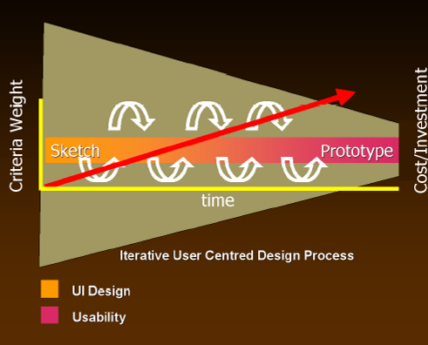
Sketching and Prototyping
Notes:
as investment in design increases (red arrow), so does the formality of the criteria whereby concepts are reviewed or accepted From design to evaluation
similarly, interface design (idea generation) progresses to usability testing (idea debugging and refinement)

Slide 53
Sketching and Prototyping
Early design
Brainstorm different representations
Choose a representation
Rough out interface style
Sketches & low fidelity paper prototypes
Task centered walkthrough and redesign
Fine tune interface, screen design
Heuristic evaluation and redesign Usability testing and redesign
Medium fidelity prototypes
High fidelity prototypes
Working systems
Limited field testing
Alpha/Beta tests
Late design

Slide 54
Scribble Sketching
Sampling the real world by rapidly sketching out ideas to capture the essence of the idea.
How
draw very quickly (few seconds)
very low fidelity
focus and emphasis on idea essence
sacrifice all other details

Slide 55
Try It
I will show you an image
15 seconds: choose a single idea or concept from that image to capture
30 seconds: scribble-sketch it

Slide 56
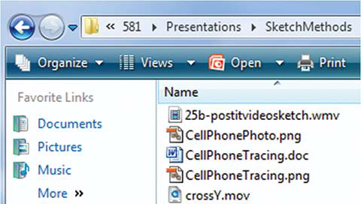

Slide 57
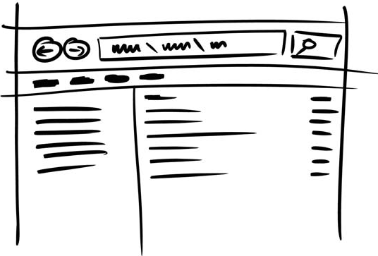

Slide 58
Example Results
Emphasis: layout
Details: highlight structures of panes, key buttons & fields
Abstracted: icons/labels/ text as caricature(漫画) scribbles
Left out: decorations, actual text, lesser interface controls

Slide 59
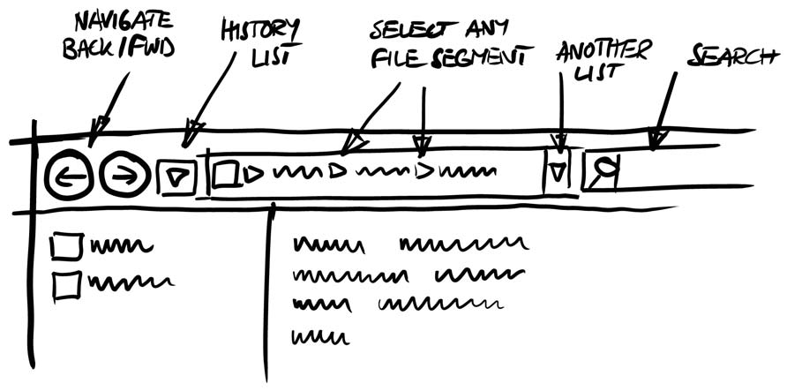

Slide 60
Example Results
Emphasis: folder navigation
Details: annotated interaction methods in the navigation bar
Abstracted: icons/labels/ text as caricature scribbles
Left out: decorations, actual text, lesser interface controls

Slide 61
Low Fidelity Prototyping
Quick to develop
Allows for explorations of ideas
Can be more difficult to conduct user studies
Zero coding!
Notes:
Paper mock-up of the interface look, feel, functionality
quick and cheap to prepare and modify
Purpose
brainstorm competing representations
Elicit（引出） user reactions
elicit user modifications / suggestions

Slide 62
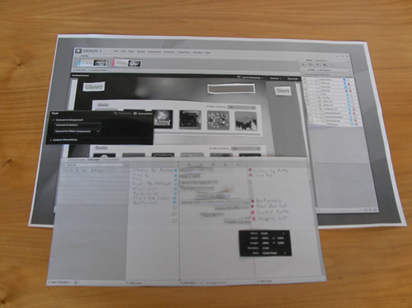
Paper Prototyping
Source: http://usereccentric.com/entries/000333.html
Notes:
http://usereccentric.com/entries/000333.html

Slide 63
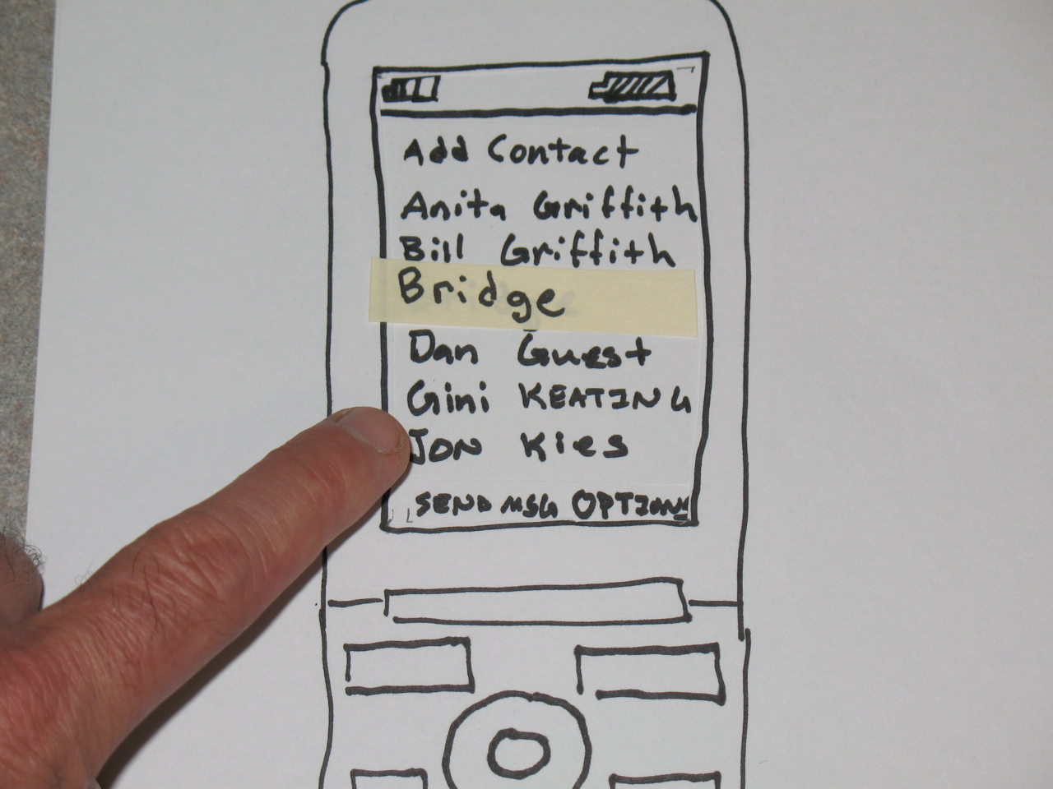
Paper Prototyping - Sketching
Notes:
drawing of the outward appearance of the intended system
crudity means people concentrate on high level concepts
but hard to envision a dialog’s progression
The attributes of sketches
Quick
to make
Timely
provided when needed
Disposable
investment in the concept, not the execution
Plentiful
they make sense in a collection or series of ideas
Clear vocabulary
rendering & style indicates it’s a sketch, not an implementation
Constrained resolution
doesn’t inhibit concept exploration
Consistency with state
refinement of rendering matches the actual state of development of the concept
Suggest & explore rather than confirm
value lies in suggesting and provoking what could be i.e., they are the catalyst to conversation and interaction

Slide 64
Catalog Shopping System
Brick and mortar store
Paper catalogs
Scan in desired item(s) with bar code reader
See item on computer screen
Complete and pay for order (which submits it)
Print it and bring to sales clerk
Sales clerk gives you item
Storyboard
buy a blue stroller（婴儿车）

Slide 65
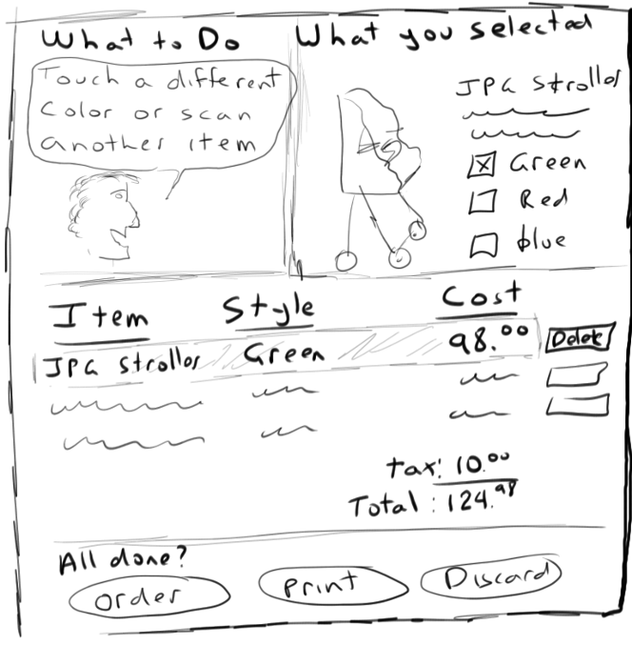

Slide 66
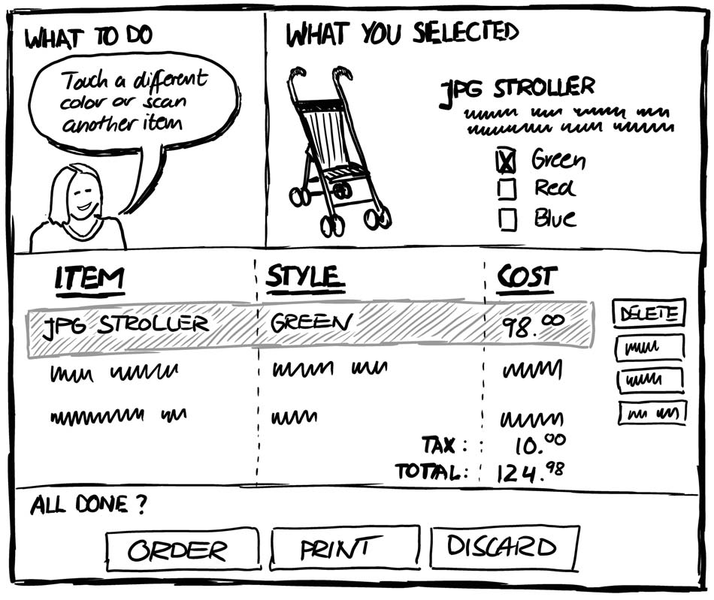

Slide 67
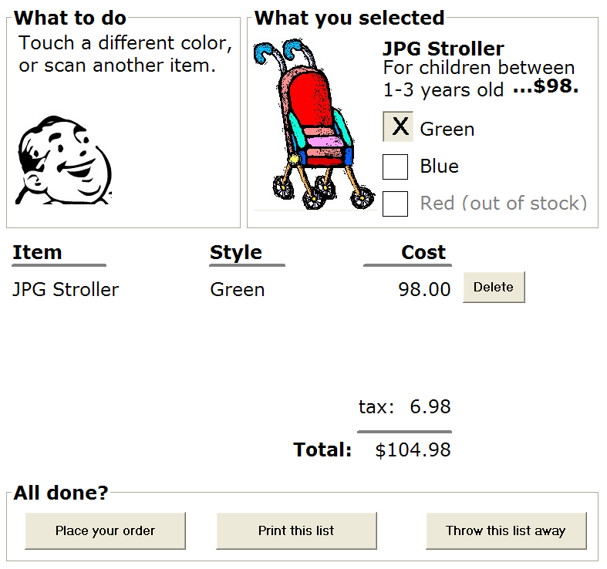

Slide 68
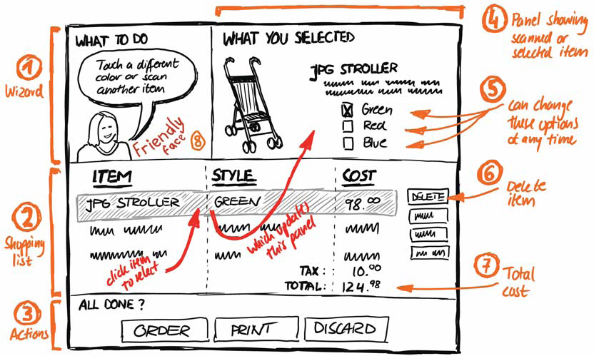
Annotations(注释)

Slide 69
Annotations
Names labels, explanatory notes
location identifies sketch parts they refer to
Example
proximity to area
braces for large areas
arrow to specific area

Slide 70
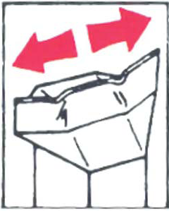
Arrows as Annotations
Can also
emphasise area of interest
relate different parts of a sketch
indicate direction
show movement
indicate a sequence of events (interaction flow)

Slide 71
Arrows Example
Interaction flow within a sketch

Slide 72
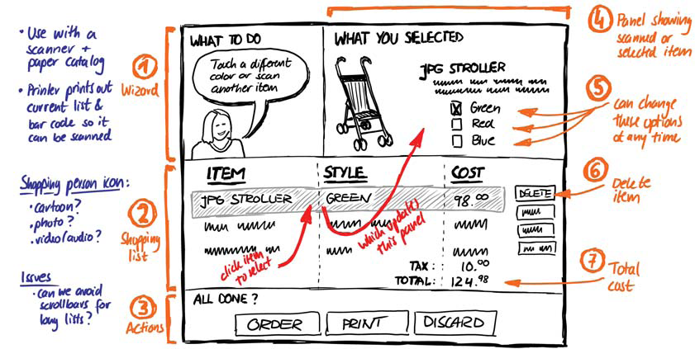
Notes
Text where spatial location is not important

Slide 73
Notes
Ideas about design elements left out of the drawing
Alternate design options of sketch elements
Design issues

Slide 74
Notes
Ideas about design elements left out of the drawing
Outstanding questions
Assumptions
Context of use…
Can be
words, lists, paragraphs, sentence fragments…

Slide 75
Storyboarding
A series of key frames as sketches
originally from film; used to get the idea of a scene
snapshots of the interface at particular points in the interaction
Users can evaluate quickly the direction the interface is heading

Slide 76
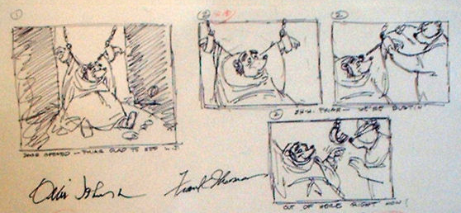
Storyboarding

Slide 77
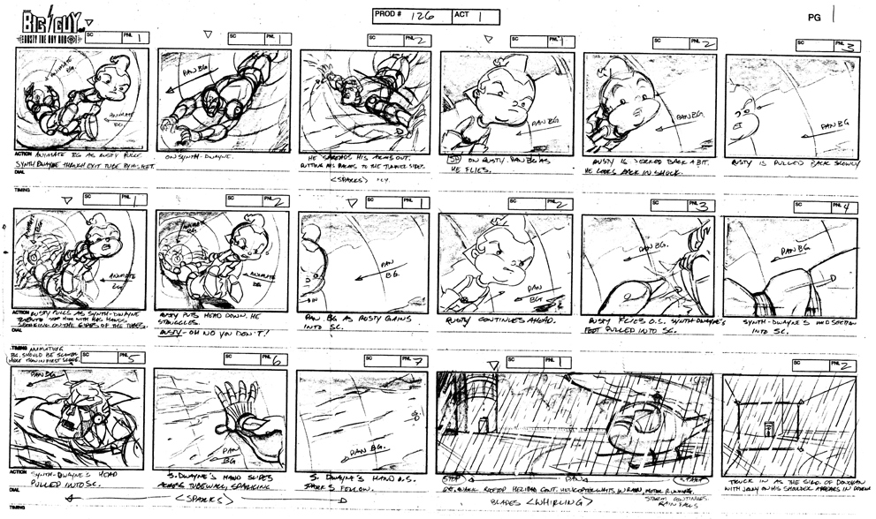
note how each scene in this storyboard is annotated

Slide 78
Sequential Storyboard
A visual narrative
Series of key frames as sketches
Interface snapshots at points in the interaction
Portrays
Key scenes in the interface
Transitions that caused the changes

Slide 79
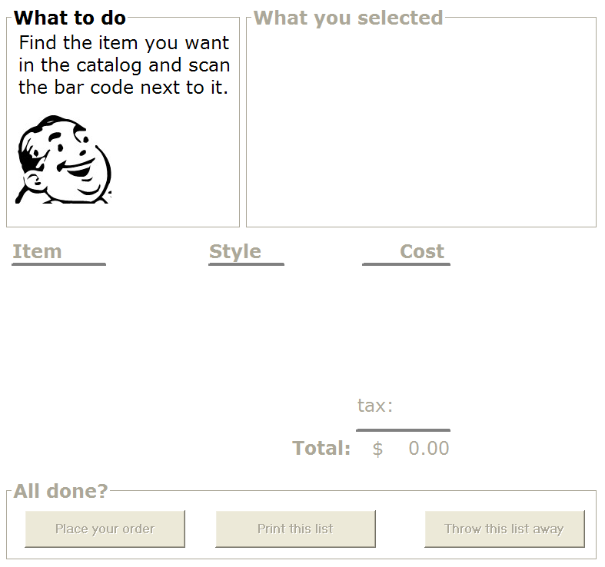


Initial screen
Scan the stroller ->
Change the color ->
Place the order ->

Slide 80
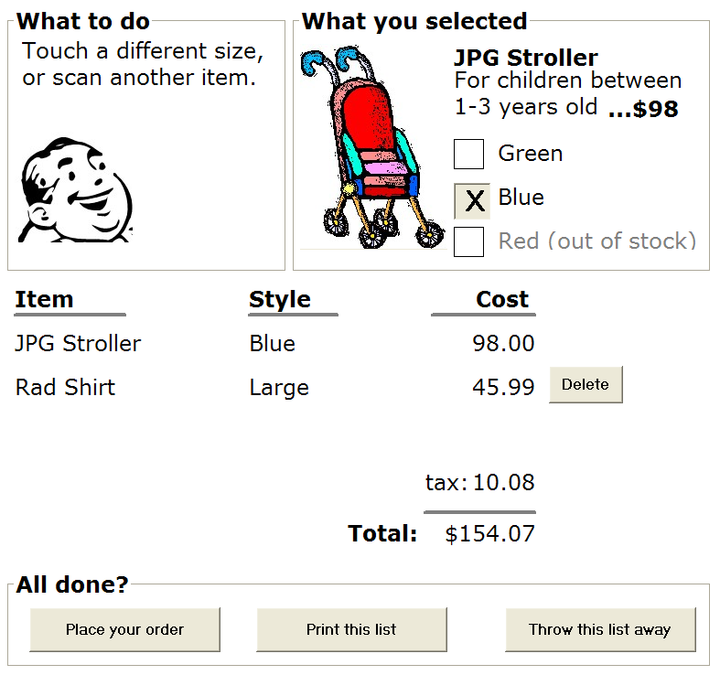
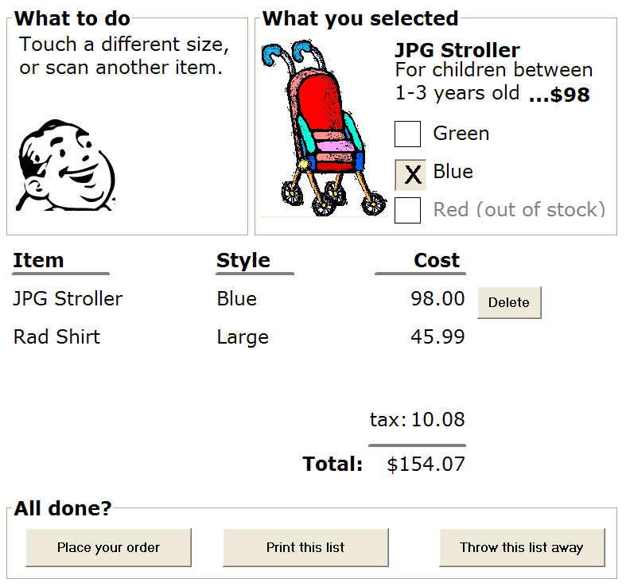
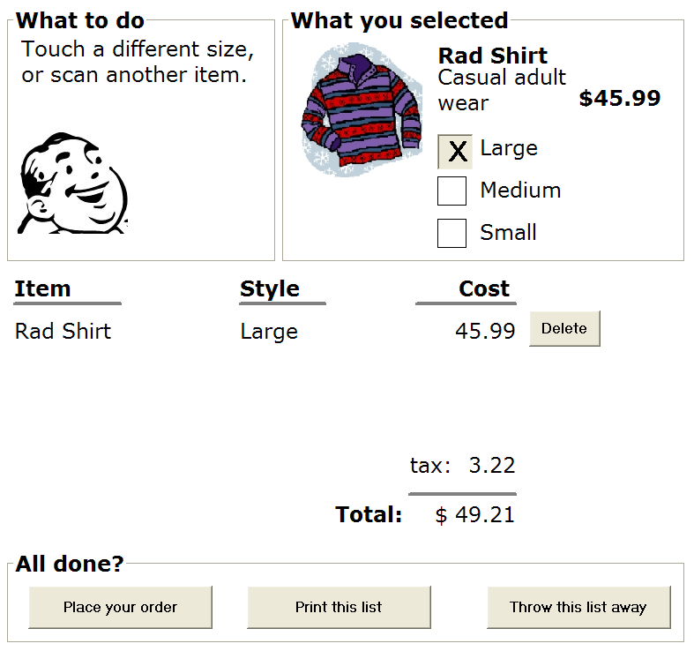
Alternate path…
Scan the shirt ->
Touch previous item ->
Delete that item->

Slide 81
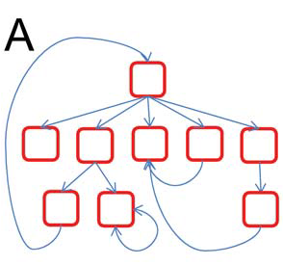
Branching Storyboard
Multiple transitions from a state
Result of
user actions
environmental actions
system configuration…

Slide 82
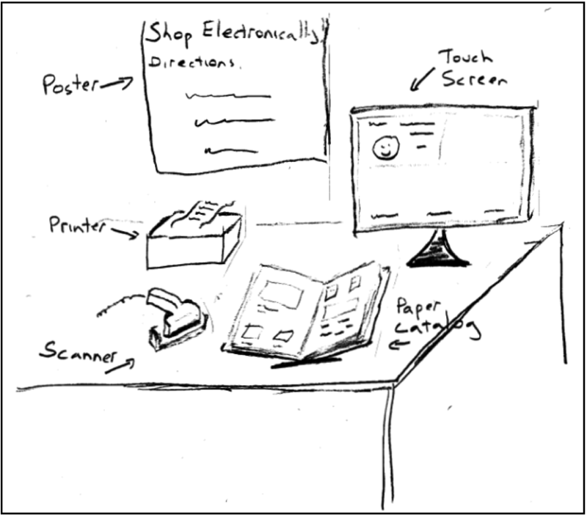

Slide 83
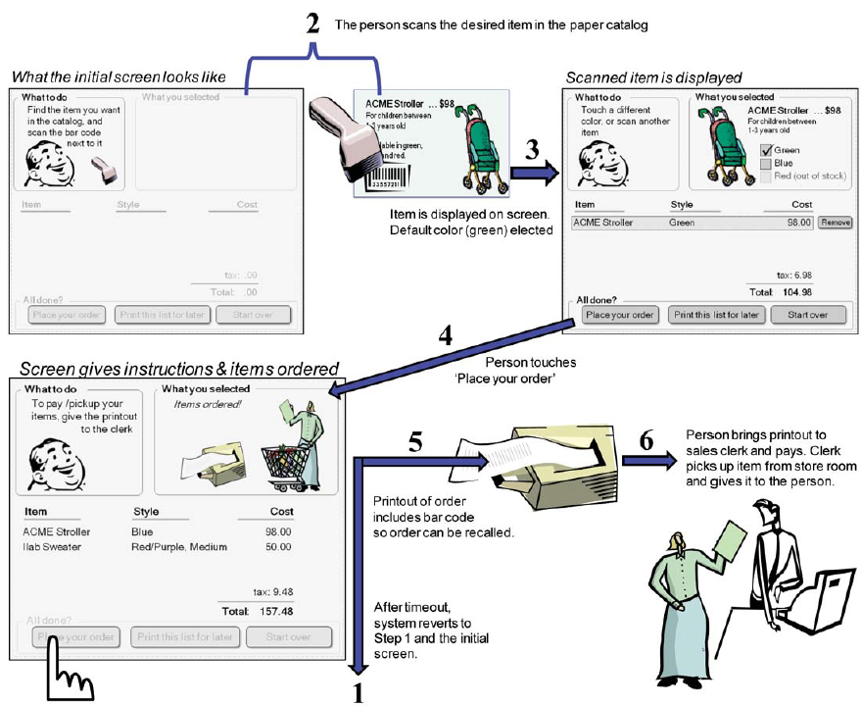

Slide 84
Catalog Shopping System
Extend it to allow a person to
scan 2 or more items
modify items in the list
print out the list, then come back later and scan in the list
not buy anything
walk away
explicitely(明确的) cancel the order

Slide 85
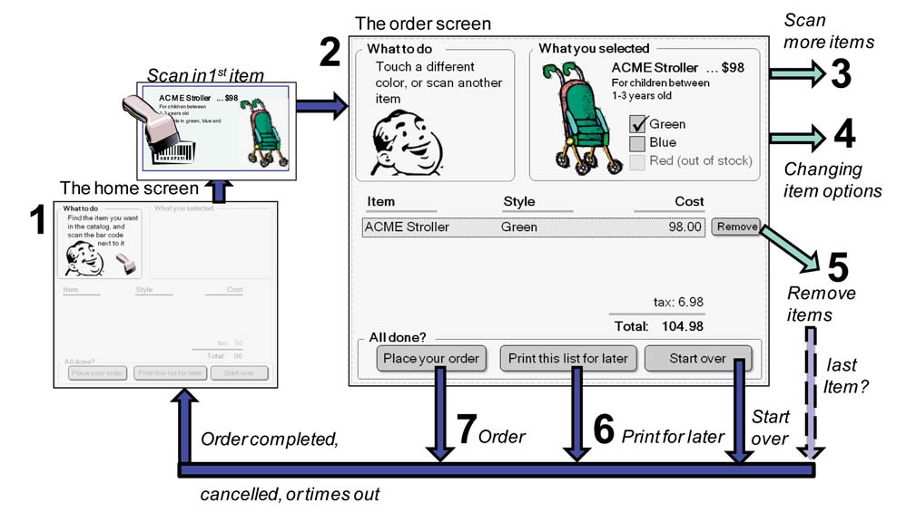
Overview Map –Basic operation

Slide 86
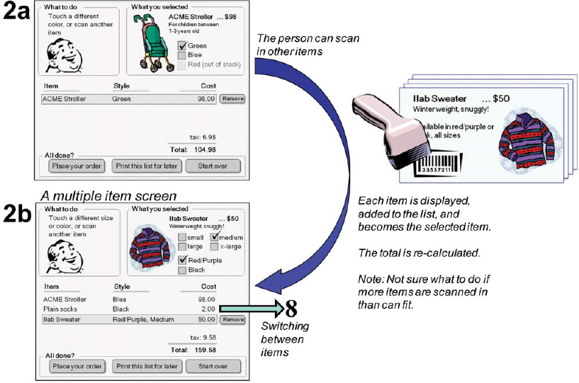
2 Scanning in Multiple Items

Slide 87
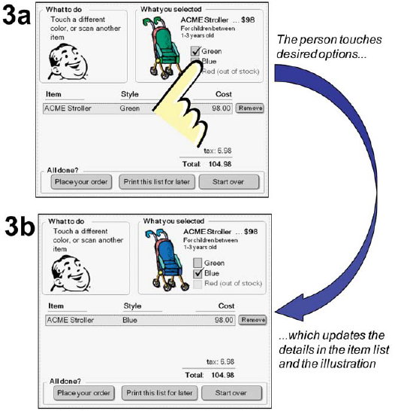
3 Changing item options

Slide 88
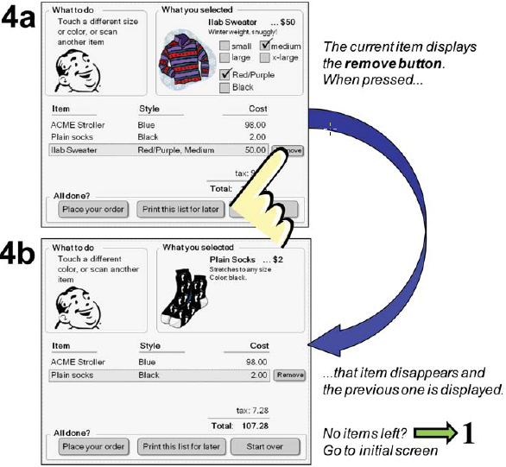
4 removing items

Slide 89
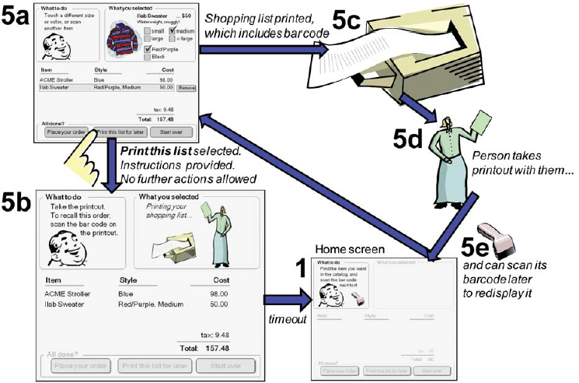
5 print for later

Slide 90
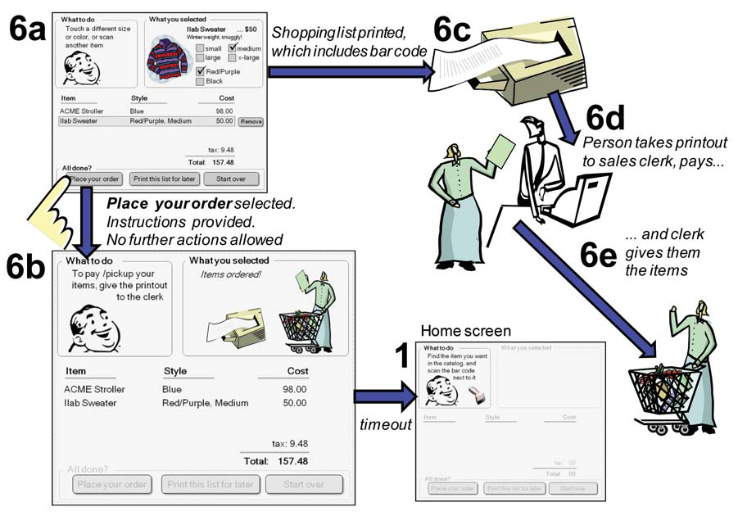
6 Place order

Slide 91
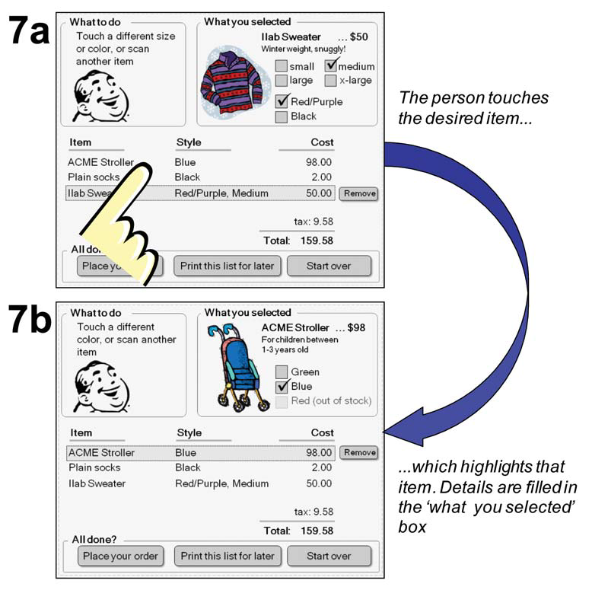
7 Switching between items

Slide 92
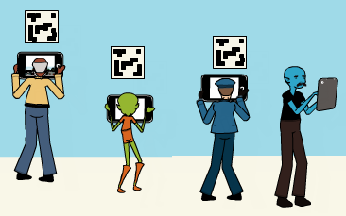
Narrative Storyboard（叙述性故事版）
Tell a story
The user experience
interface only part of the story
Narrative
includes context of use
a more complete story

Slide 93
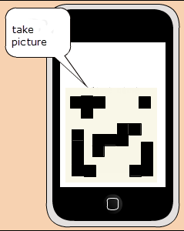
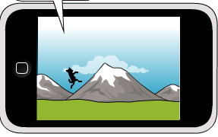
Interface vs. Narrative Storyboard

Slide 94
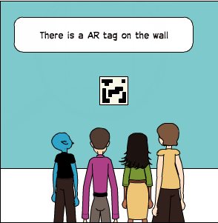
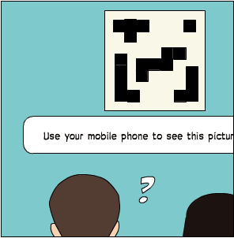
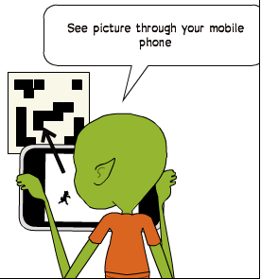
Image modified by S. Greenberg from: http://2012.idea9104.net/archives/1473 by yokoyokoyoko

Slide 95
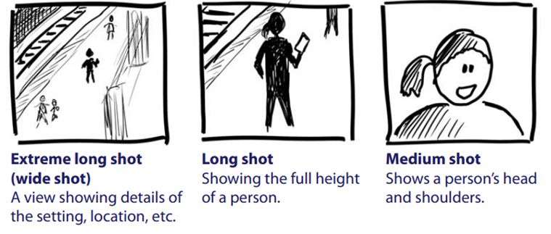
Vocabulary of Camera Shots
远景
中景
超远景（全景）

Slide 96
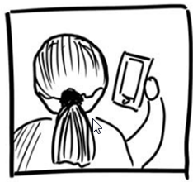
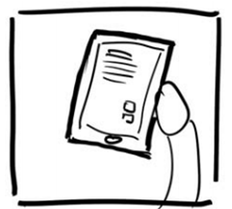
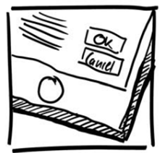
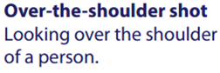
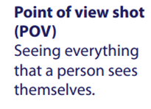
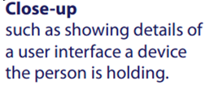
Vocabulary of Camera Shots
过肩镜头
主镜头
近景

Slide 97
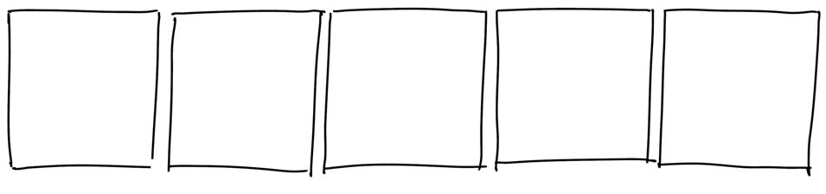
1. Outline storyboard frames
5 boxes often suffice to illustrate one scenario

Slide 98
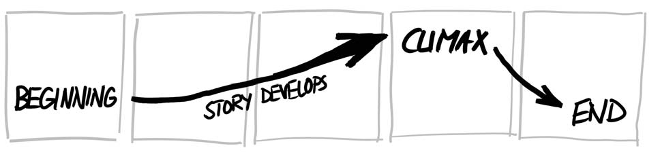
2. Develop the Storyline
Where does the interaction take place?
What is the problem?
What is the task a person is trying to do?
Which people are present / what are their actions?
What objects/devices do they use?
What are the input / outputs?
How do their actions solve the problem?

Slide 99
2. Develop the Storyline
establishing shot
story develops to climax
conclusion

Slide 100
A Storyline
Fred passes by a public announcement board &
He is interested in more info about 1 announcement
He uses the phone to capture bar code next to display
He reads detailed info that appears on the phone
He walk away

Slide 101
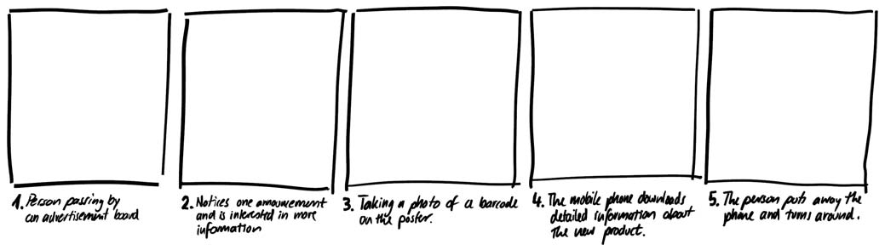
2. Develop the Storyline
1. A person passes by an advertisement board
3. Taking a photo of a barcode on the poster
5. Person puts phone away and turns around
2. Notices one advertisement and is interested in more information
4. Mobile phone downloads detailed info about that product

Slide 102
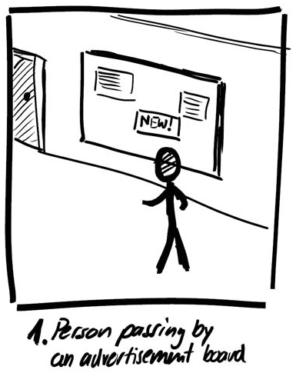
3. Sketch Establishing Shot
The introduction
location where interaction takes place
people involved
setting
The shot
long shot
Alternate shots OK
hallway（走廊）
airport
multiple people…

Slide 103
3. Sketch Establishing Shot
Use appropriate shots
extreme long shot
emphasizes context
Image from:

Slide 104
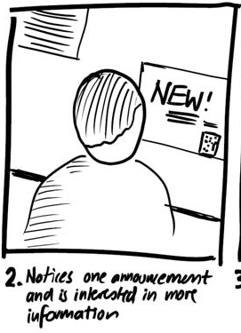
4. Continue storyline
Use appropriate shots
over the shoulder
emphasise person looking at something of interest
Image from:

Slide 105
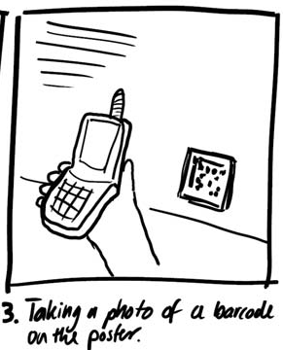
4. Continue storyline
Use appropriate shots
point of view
emphasises person’s action
Image from:

Slide 106
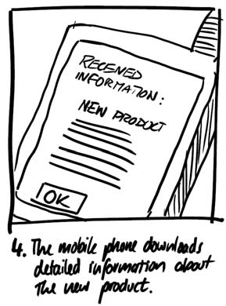
4. Continue storyline
Use appropriate shots
close-up
shows detail
The climax
Image from:

Slide 107
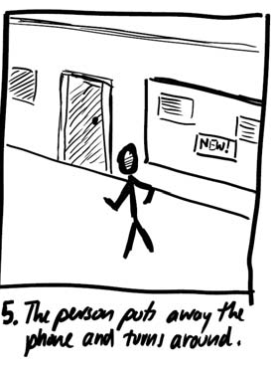
4. Continue storyline
Use appropriate shots
extreme long shot
shows context on completion
Conclusion
Image from:

Slide 108
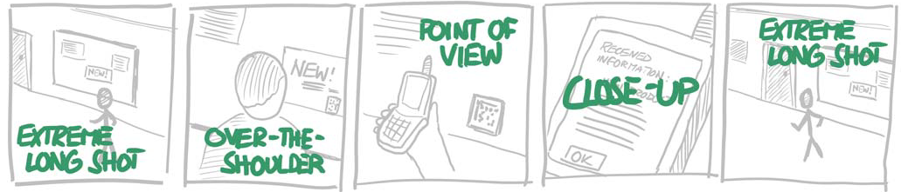
4. Continue storyline
Image from:

Slide 109

5. Emphasize Actions and Motions
Image from:
Large arrow emphasises a person walking by

Slide 110


5. Emphasize Actions and Motions
Circling arrow emphasises motion as he notices something of interest
Question mark reveals emotions (interest)
Image from:

Slide 111

5. Emphasize Actions and Motions
Area emphasises photo-taking action

Slide 112

5. Emphasize Actions and Motions
Highlights emphasises action of information received

Slide 113

5. Emphasize Actions and Motions
Arrow emphasises person walking away

Slide 114

5. Emphasize Actions and Motions
Image from:

Slide 115
6. Demonstrate and Iterate
Show and get critique（评论）
is it realistic?
is the context plausible?
are the person’s motivatins plausible
would they really do those actions?
Develop alternate scenarios

Slide 116





Steps 3+4. Use Snapshots Instead (Alternate)
Tip: exaggerate poses

Slide 117

Alternate Print Them
Tip: 10×10CM minimum / photo

Slide 118

Alternate Annotate Them
Tip: thick markers / tracing paper for alternates

Slide 119

Alternate Annotate Them
Tip: annotations an extend beyond boundaries

Slide 120

Alternate Draw additional elements
Tip: Leave space on photos / white it out, or…

Slide 121


Alternate Draw additional elements
Tip: Use office supplies to create overlays

Slide 122

Alternate Add Storyline

Slide 123

Complete Narrative Storyboard (Alternate)

Slide 124
Medium Fidelity Prototyping
More “real” user experience
Longer design time
Longer development time
Some level of programming
“Golden Path” / Slideshow
Notes:
Prototyping with a computer
simulate some but not all features of the interface
engaging for end users
purpose
provides sophisticated but limited scenario for the user to try
can test more subtle design issues
dangers
user’s reactions often “in the small”
users reluctant to challenge designer
users reluctant to touch the design
management may think its real!

Slide 125


Medium Fidelity

Slide 126
Scripted simulations
Create storyboard with media tools
scene transition activated by simple user inputs
a simple vertical prototype
User given a very tight script/task to follow
appears to behave as a real system
script deviations blow the simulation

Slide 127


Slide 130


Slide 131
High Fidelity Prototyping
Closer to reality
Greater design requirements
More development time
Can serve as a reference platform for other groups (Engineering, QA, Marketing)

Slide 132

High Fidelity

Slide 133
Chapter 6 Interaction Design
Thank you！

